Slide 1
TSUNAMI All OVER THE WORLD
data mining and machine learning final project
Yuval Zvi Adar
Avi Shilon

Slide 2

Our Research
Research question:
Can we predict the cause of tsunami by location?
Latitude, Longtitude data
Predicted cause

Slide 3
Data sources
https://en.wikipedia.org/wiki/List_of_tsunamis
https://data.world/dhs/historical-tsunami-event
https://www.ngdc.noaa.gov/hazel/view/hazards/tsunami/event-data?minYear=1800

Slide 4
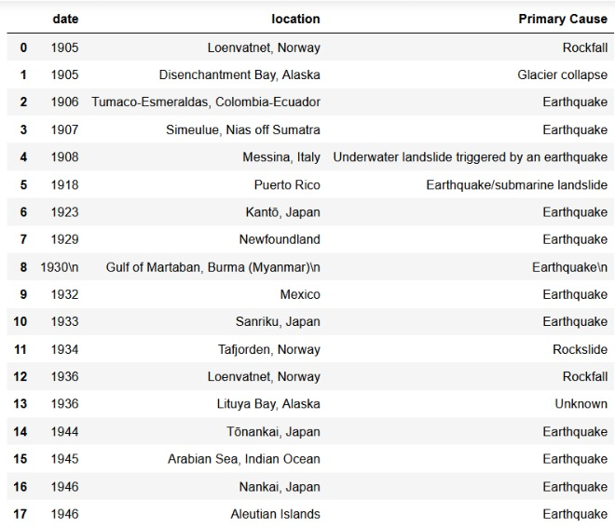
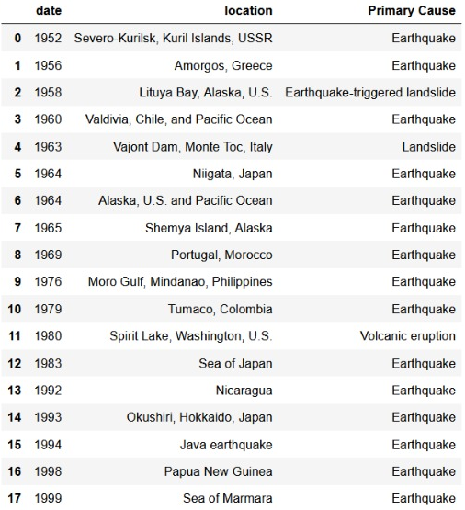
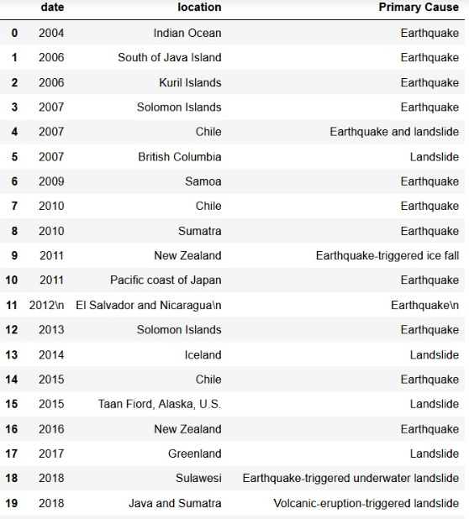
Wikipedia-Crawling
Finding tsunami event over the years, and crawling the data (year, location and primary cause).
1900-1950
1950-2000
2000-present

Slide 5
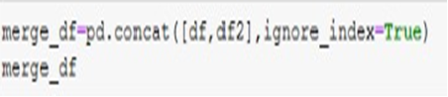
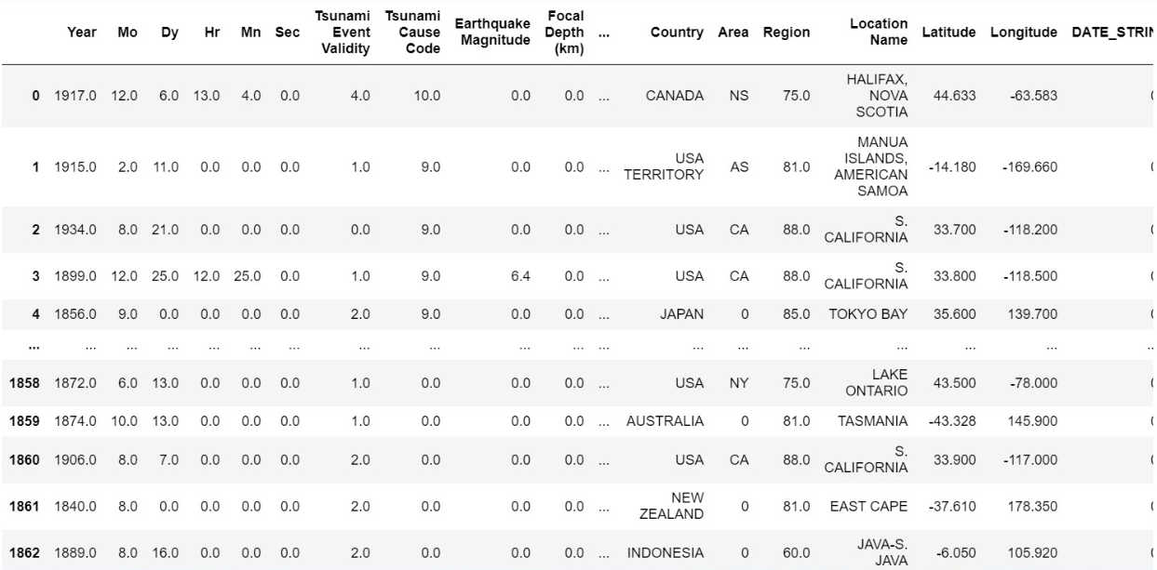
Merge Data
We merge two different information source(df,df2) to one table with all the information(merge_df).

Slide 6
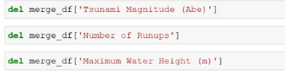
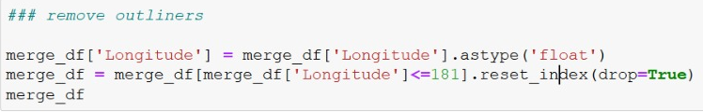


Data Cleaning
We deleted columns that are irrelevant to the topic we’re research
We remove outliners
We fill in an empty cells
We deleted the Nan value
by the relevant columns
and sort ‘Tsunami
cause code’ column

Slide 7
Tsunami Examples
Tsunami 1969 Portugal, Morocco
Tsunami 1999
Sea of Marmara
A large undersea earthquake off the coast of Portugal generated a tsunami that affected both Portugal and Morocco.
The earthquake triggered a tsunami in the Sea of Marmara, with a maximum water height of 2.52 m. 150 people were killed when the town of Degirmendere was flooded and a further five were swept into the sea at Ulaşlı

Slide 8
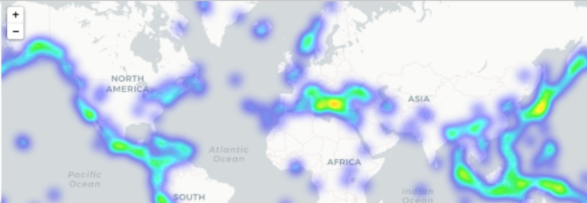
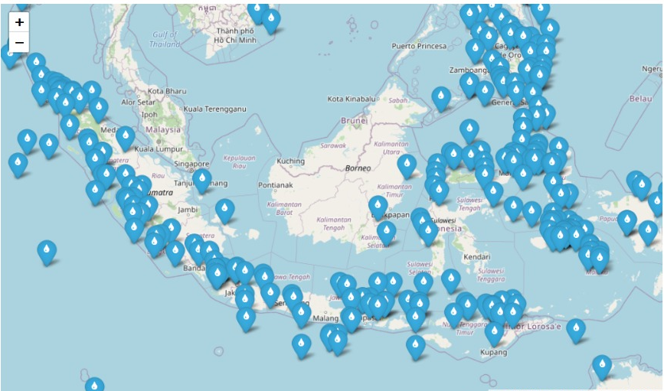
Exploring & Visualizing the Data
Heatmap
Visualizing locations with scatter plot

Slide 9
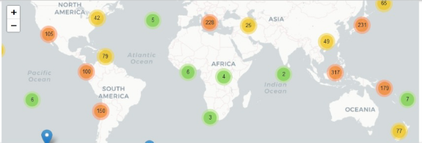
Exploring & Visualizing the Data
Mapping scatter plot

Slide 10
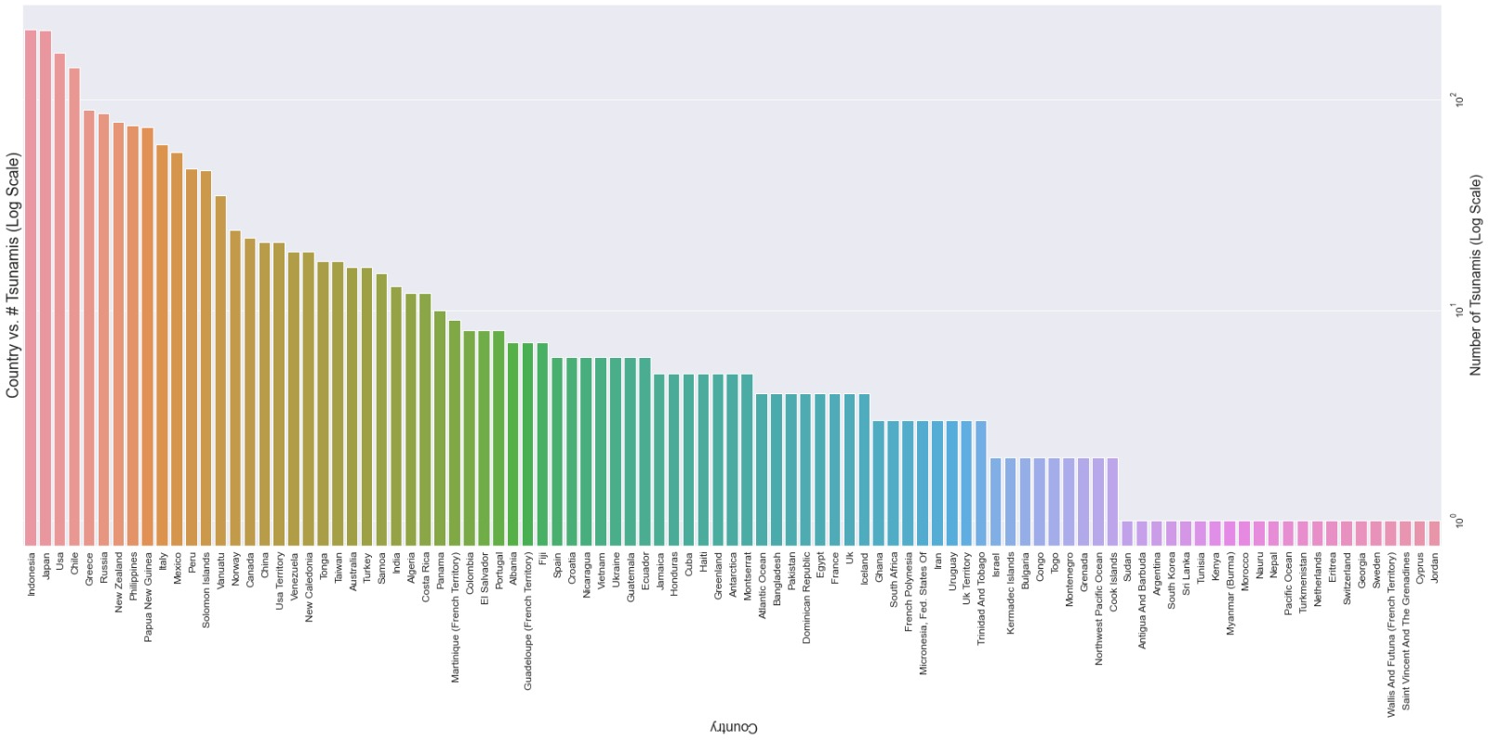
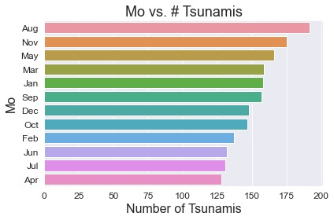
Exploring & Visualizing the Data
Mo vs. #Tsunami
Country vs. #Tsunami

Slide 11
Machine Learning

Slide 12
01
Tsunami cause code
'Unknown', 'Earthquake', 'Questionable Earthquake', 'Earthquake and Landslide', 'Volcano and Earthquake', 'Volcano, Earthquake, and Landslide’, 'Volcano', 'Volcano and Landslide', 'Landslide', 'Meteorological', 'Explosion', 'Astronomical Tide'
0
02
03
04
05
06
07
08
09
10
11

Slide 13
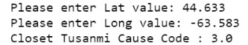
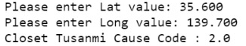
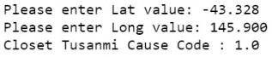
ML – Linear Regression
CANADA
JAPAN
AUSTRALIA
Using `sklearn` library and linear regression
we were able to train a model that predicts the Tsunami cause code
The model predicted the cause of tsunami by longitude and latitude points

Slide 14
Our conclusion
According to the data and the machine learning,
the main cause of the tsunami appears to be an earthquake.

